Slide 1
Single Source Shortest Path

Slide 2
General Results (Relaxation)
Lemma 24.1: Let p = ‹v₁, v₂, …, v_{k}› be a SP from v₁ to v_{k}. Then,
p_{ij} = ‹v_{i}, v_{i+1}, …, v_{j}› is a SP from v_{i} to v_{j}, where 1 ≤ i ≤ j ≤ k.
So, we have the optimal-substructure property.
Bellman-Ford’s algorithm uses dynamic programming.
Dijkstra’s algorithm uses the greedy approach.
Let δ(u, v) = weight of SP from u to v.
Corollary: Let p = SP from s to v, where p = s u →v. Then,
δ(s, v) = δ(s, u) + w(u, v).
Lemma 24.10: Let s ∈ V. For all edges (u,v) ∈ E, we have
δ(s, v) ≤ δ(s, u) + w(u,v).

Slide 3
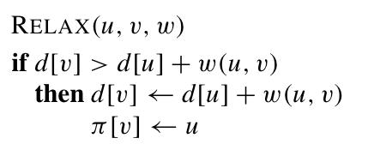
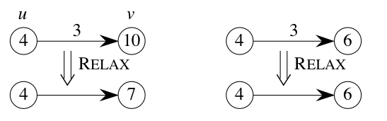
Basic Operation: Relaxation
Maintain shortest-path estimate d[v] for each node
d[v]: initialize ∞
Intuition:
Do we have a
shorter path
if use edge (u,v) ?

Slide 4
Properties of Relaxation
d[v], if not ∞, is the length of some path from s to v.
d[v] either stays the same or decreases with time
Therefore, if d[v] = δ(s, v) at any time, this holds thereafter
Note that d[v] ≥ δ(s, v) always
After i iterations of relaxing on all (u,v), if the shortest path to v has i edges, then d[v] = δ(s, v).

Slide 5
v
3
5
u
2
1
1
3
y

Slide 6
Single Source Shortest Path
BellmanFord & Dijkstra’s Algorithm

Slide 7
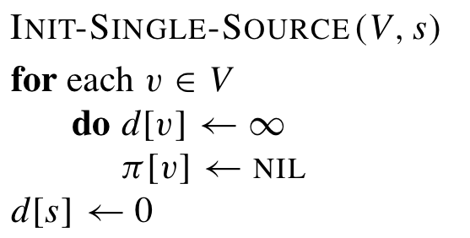
Bellman-Ford Algorithm
Allow negative weights
Follow the framework that first, initialize:
Then apply a set of Relax
compute d[v] and π[v]
Return False if there exists negative cycles

Slide 8
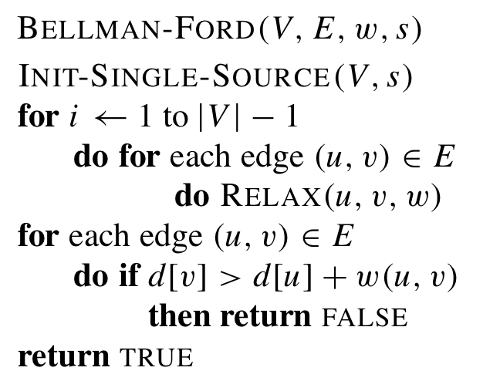
Pseudo-code
Time complexity:
O(VE)

Slide 9
Example
a
b
5
∞
∞
–2
6
–3
8
z
0
7
–4
7
2
∞
∞
9
x
y

Slide 10
Example
a
b
5
6
∞
–2
6
–3
8
z
0
7
–4
7
2
7
∞
9
x
y

Slide 11
Example
a
b
5
6
4
–2
6
–3
8
z
0
7
–4
7
2
7
2
9
x
y

Slide 12
Example
a
b
5
2
4
–2
6
–3
8
z
0
7
–4
7
2
7
2
9
x
y

Slide 13
Example
a
b
5
2
4
–2
6
–3
8
z
0
7
–4
7
2
7
-2
9
x
y

Slide 14
Summary
Given edge (u,v)
δ (s,v) ≤ δ (s,u) + w(u,v)
Relax(u,v,w)
If d[u] = δ (s,u) before the operation
Then d[v] = δ (s,v)
Path relaxation property

